Slide 1
Project 4 Hospital Patients Readmitting Deep Learning and SVM Application
Done by:
Mohammad Kharoof
Obada Issa
Yara Rashed

Slide 2
Introduction
Do customer reviews really matter? The answer is a strong yes. With the emergence of online platforms, customers can share their experience with the world in just a few clicks. Nowadays, the reviews are not only found on e-commerce websites they may be across the web from social media to blogs and forums. And of course, there are websites dedicated to customer reviews, such as TripAdvisor and Yelp. All of those sources allow consumers to freely give their opinion about the products, whether they be positive or negative. These reviews are a valuable asset for any B2C company and can be crucial for a business. Why are they so important? How can companies use them? Here is everything you need to know about the importance of customer reviews.
Data science has improved exponentially over the last years and it has opened the doors to multiple ways of engineering all of that data. One way was to apply machine learning to the data in order to predict something based on an existing dataset in a set of algorithms called unsupervised machine learning algorithms.
As an example of these algorithms we have the Artificial Neural Networks(ANN) and the Convolutional Neural Networks (CNN). Thus, giving the birth to Deep learning which is a subset of machine learning. It is completely based on biological neurons but more on that later. Smart Bridge has offered us the Hotel Reviews dataset which has 515738 datapoints and 2 main features being Negative Reviews and Positive Reviews along with the label being Reviewer_Score.
Our job is to process this dataset and come up with an NLP model that can predict how good a certain review is.

Slide 3
Overview of the Project
As mentioned before, this dataset is from different cities and countries and as a note this dataset is massive.
These recorded features contained the following:
Positive_Review;
Negative_Review;
Address;
Nationality;
Hotel_Name;
This dataset had 2 main features to focus on and the rest was simply ignored since this is an NLP.
The Positive and Negative reviews were added into a review list.
This list was then turned into a numeric form using NLTK.
Then it was passed into an ANN with 2 hidden layers.
Each hidden layer had 1500 neurons.

Slide 4
Emphasis on the Problem
Analyzing reviews left to you by customers helps keep your feet on the ground in respect to overall customer satisfaction, as they can provide your business with feedback regarding what your customers truly want. By using this information as input, you will be able to improve customer service by quickly and efficiently resolve the issues that consumers faced, thereby creating a positive experience for the consumer and keeping your focus on their needs.
No doubt, we are social creatures since the moment we come to this world and we are interested in knowing what other say before we make our buying decisions. Much like we would ask friends and family for recommendations, review sites allow us to do this online with just some clicks.
Reviews enable new businesses to stand shoulder to shoulder with more established competition, and potentially gain a positive niche in people’s estimation and expectations. Look at it this way…which company would you rather buy from: one with 50 3-star reviews or one with 5 5-star reviews? Voila! You just took the discussion away from the discount and price!

Slide 5
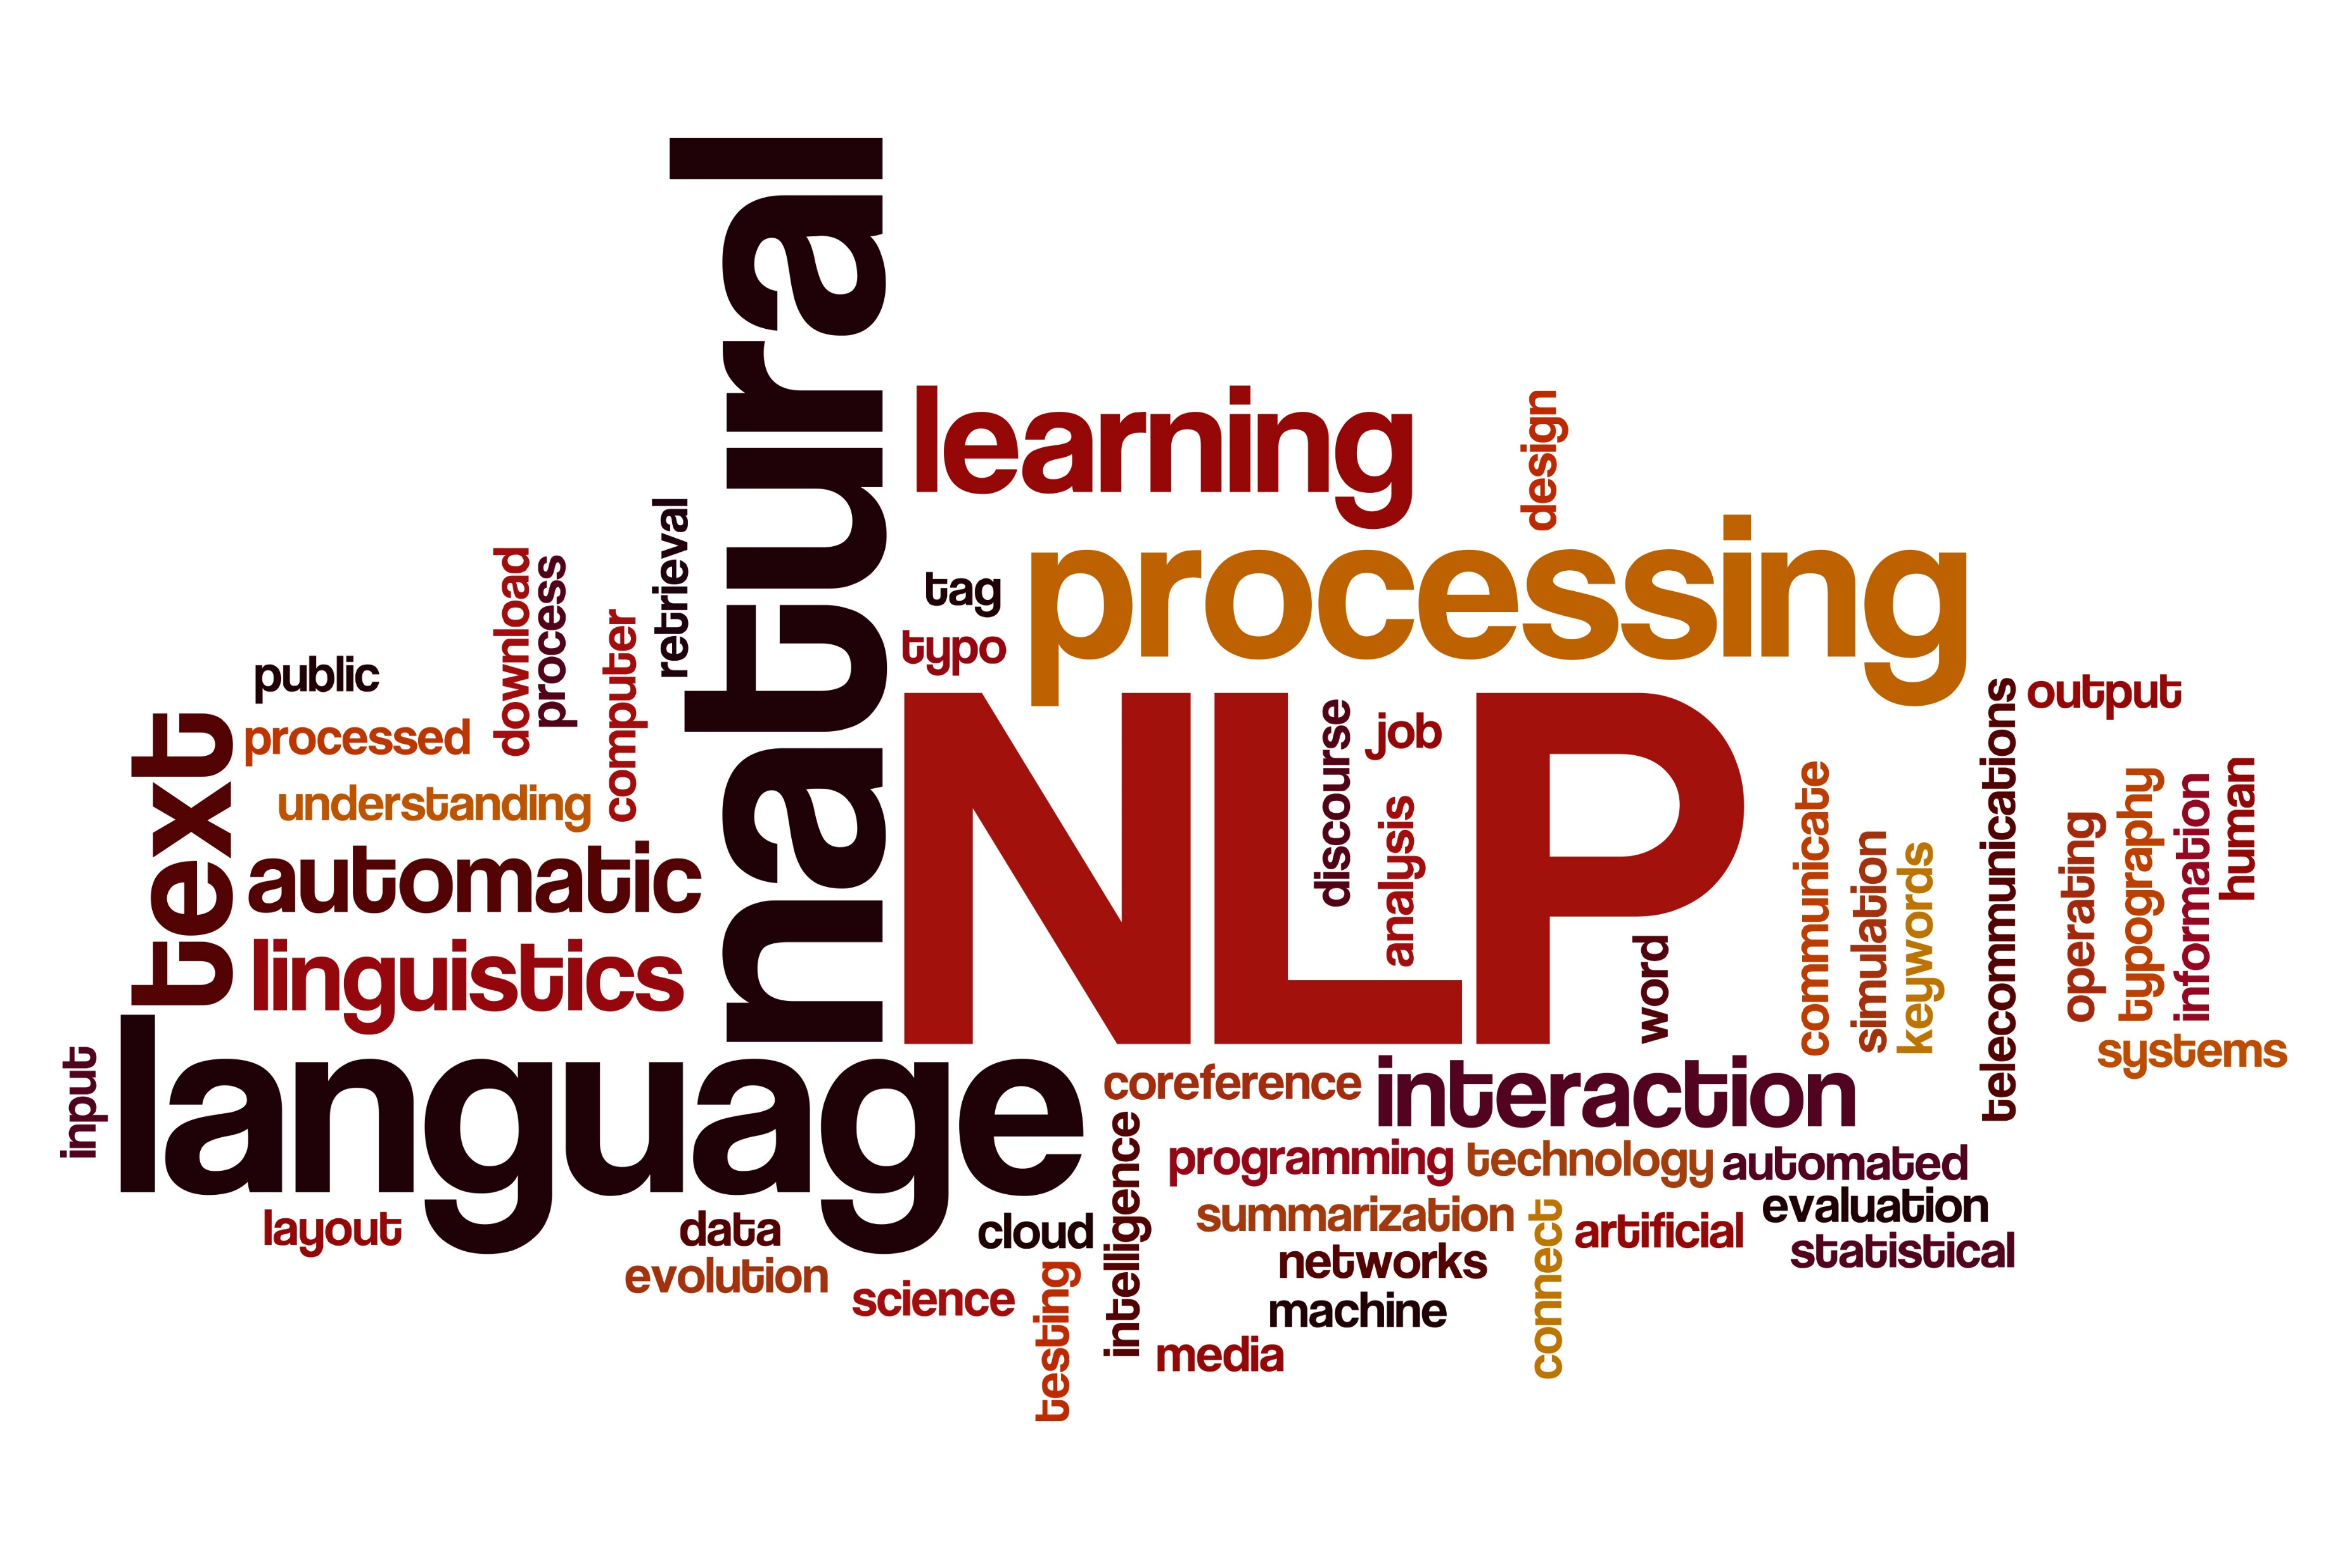
Objectives
To process the dataset provided.
Apply NLP on the dataset.
Using ANN and NLP to predict a review score.
Discussion of Results.

Slide 6
Dataset Description
The dataset contains the following features:
Hotel_Address
Additional_Number_of_Scoring
Review_Date Average_Score
Hotel_Name Reviewer_Nationality
Negative_Review
Review_Total_Negative_Word_Counts Total_Number_of_Reviews
Positive_Review Review_Total_Positive_Word_Counts Total_Number_of_Reviews_Reviewer_Has_Given Reviewer_Score
Tags
days_since_review
lat
lng

Slide 7
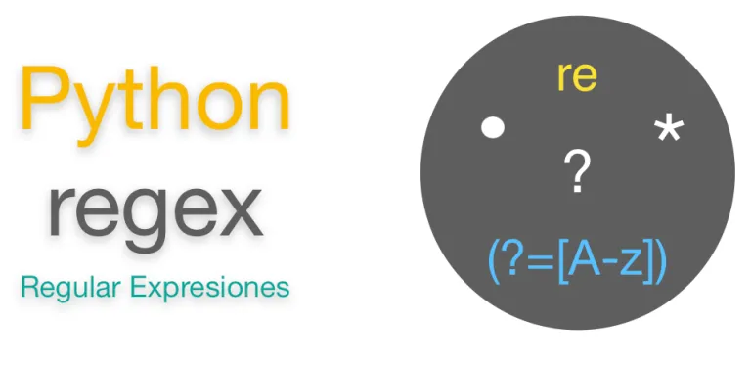
RE:
In this project, we have used the Regular expression library (re) library.
It is used to preprocess the text and to reformat it.
It has the ability to detect and work with patterns. We used this to remove punctuations.
https://docs.python.org/3/library/re.html

Slide 8
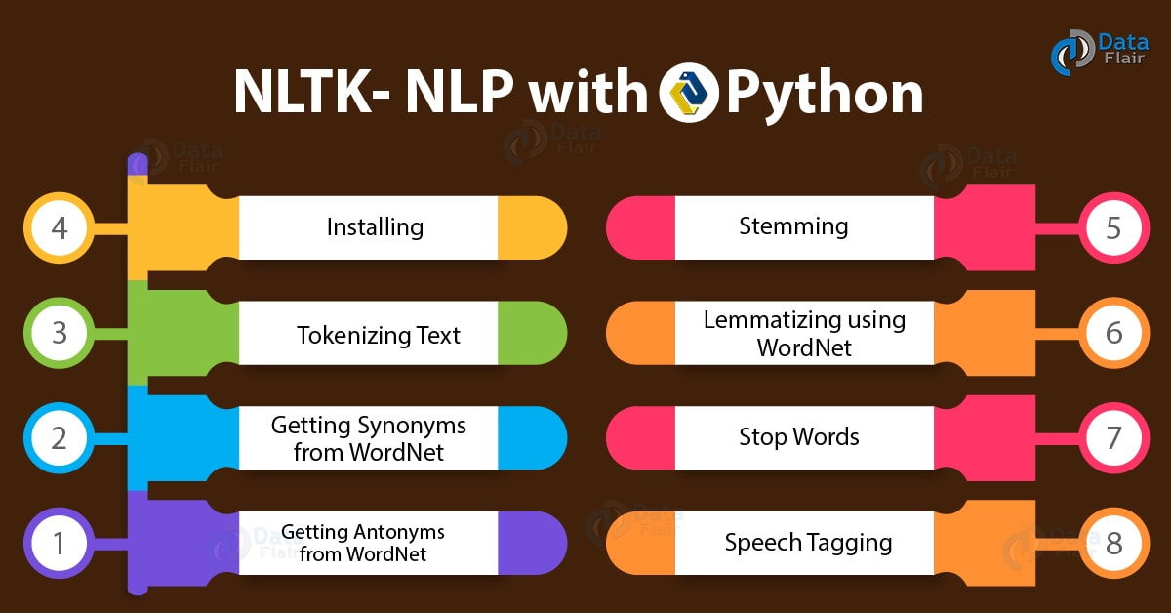
NLTK:
In this project, we have used the Natural Language Toolkit library (nlkt) library.
NLTK is a leading platform for building Python programs to work with human language data. It provides easy-to-use interfaces to over 50 corpora and lexical resources such as WordNet, along with a suite of text processing libraries for classification, tokenization, stemming, tagging, parsing, and semantic reasoning, wrappers for industrial-strength NLP libraries, and an active discussion forum.
Bird, Steven, Edward Loper and Ewan Klein (2009), Natural Language Processing with Python. O’Reilly Media Inc.
https://www.nltk.org/

Slide 9

TensorFlow:
In this project, we have used the Tensorflow library.
TensorFlow is an end-to-end open source platform for machine learning. It has a comprehensive, flexible ecosystem of tools, libraries and community resources that lets researchers push the state-of-the-art in ML and developers easily build and deploy ML powered applications.
https://www.tensorflow.org/

Slide 10

Keras:
In this project, we have used the Keras library from TensorFlow.
Keras is an API designed for human beings, not machines. Keras follows best practices for reducing cognitive load: it offers consistent & simple APIs, it minimizes the number of user actions required for common use cases, and it provides clear & actionable error messages. It also has extensive documentation and developer guides.
https://keras.io/

Slide 11
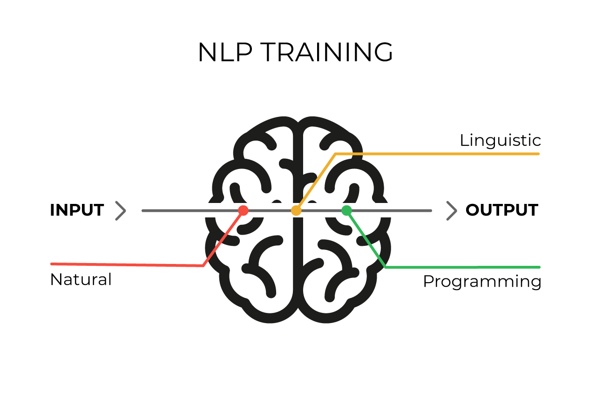
NLP:
Natural Language Processing (NLP) is the concept we will use in this project.
NLP depends on the tokenization of words and then make predictions based on that.
So what we did was as follow:
We used the re library to format the texts.
We then used NLTK to tokenize these texts.
Then the Deep Learning was ready to start.
1 Input Layer.
2 Hidden Layers.
1 Output Layer.
https://keras.io/

Slide 12
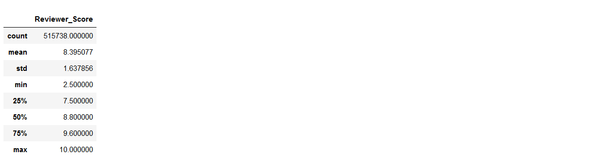
EDA
Notes:
Count: How many values were recorded.
Mean: mean.
std: standard deviation.
Min: minimum value.
25%: 25th percentile
50%: 50th percentile
75%: 75th percentile
Max: maximum value.

Slide 13
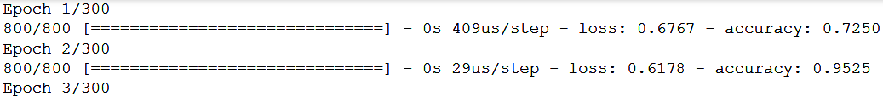
ML
The difference between the first 2 epochs.

Slide 14
ML
Epoch number 300.

Slide 15
Summary and Findings
The dataset was indeed massive. However, it had a mean of 8.4 and a standard deviation of 1.6.
This has damaged the dataset and made the minor negative reviews act like noise.
This can be treated by changing the percentage of the positive reviews and lowering the mean to ~5.
We will lose lots of data if we do that.
It is not ethical as it is not our data to do that and it is lying statistically.

